Slide 1
Adaptations

Slide 2
By the end of the lesson, you should be able to:
Define what an adaptation is.
Describe the three types of adaptations.
Distinguish between ectothermic and endothermic organisms.

Slide 3
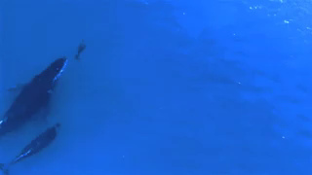
Every animal and plant on Earth has special features that help them to survive in their environment.
These special features are known as adaptations. The three main types of adaptations include:
1. | Structural
2. | Behavioural
3. | Physiological

Slide 4
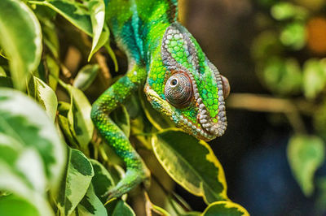
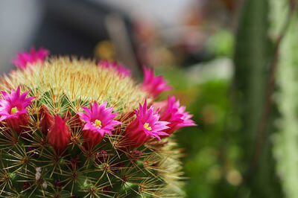
Some plants and animals have changed their physical shape or form to help them survive.
Changes in physical form include things like the beak on a bird, the fur on a bear or thorns on a cactus.
These changes are known as physical adaptations.

Slide 5
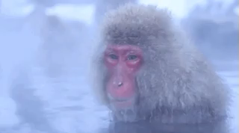
Insulation is one important structural adaptation used by mammals and birds for thermoregulation.
This is how they keep their bodies at a constant temperature.
Hair, feathers or layers of fat under the skin can reduce the flow of heat between the animal and its environment, keeping the body nice and warm.

Slide 6

Plants and animals can take special actions to help them survive.
These special actions are known as behavioural adaptations.
Bird calls, migration and hibernation are examples of behavioral adaptations. These behaviours are not learned; rather the organisms are born with instinctive knowledge.

Slide 7
Hibernation is a behavioural adaptation of some animals.
This is a special, very deep sleep. The animal's body temperature drops and its heartbeat and breathing slow down. It uses as little energy as possible.

Slide 8
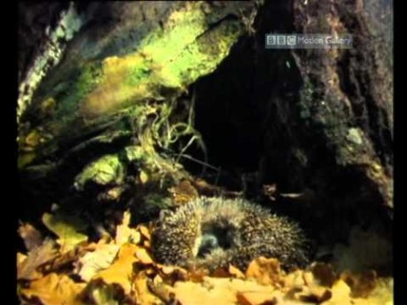

Slide 9
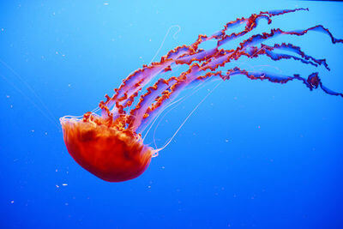
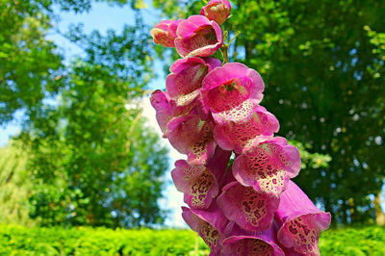
Some body parts of plants and animals are able to perform special functions to help them survive.
These special functions are known as physiological adaptations.
Examples of physiological adaptations include a snake's ability to inject venom, and general functions such as thermoregulation, growth, development and fighting infections.

Slide 10
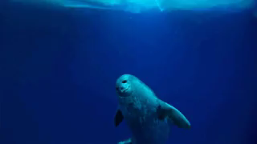
Here is another specific example of a physiological adaptation:
In seals and other marine mammals, the blood vessels near the surface of the body constrict when they're swimming in cold water. This directs more blood to the body's core, keeping the important parts warm.

Slide 11
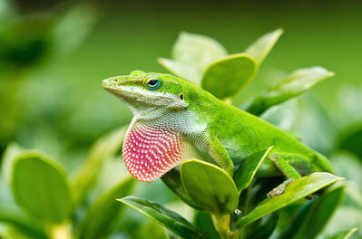
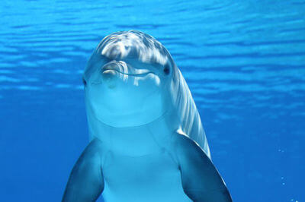
Let's look at an example!
How do animals keep their bodies at the right temperature?
It turns out that different animals have different adaptations for keeping cosy. Animals can be classified as either ectothermic or endothermic. Let's see what those words mean!

Slide 12
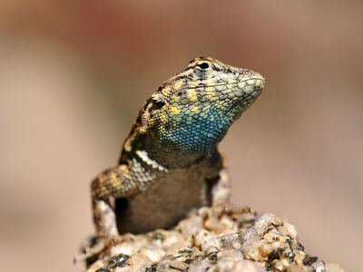
Fish, amphibians, reptiles and invertebrates rely on their surroundings to control their body temperature - they are ectothermic.
Their body temperature varies according to their environment.
They can warm up by sitting on a warm rock, or cool down by burrowing into the ground. These are both examples of behavioural adaptations.

Slide 13
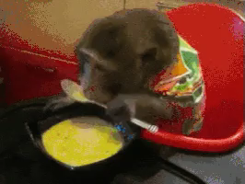
Mammals and birds are endothermic.
They control their body temperature by using internal chemical reactions to generate heat themselves - an important physiological adaptation.
Endothermic animals need to consume a lot more energy, in order to sustain the chemical reactions. That's why many reptiles can go for months without eating, but us humans need three meals a day!

